Slide 1
Hotel Booking
Submitted by
Alaa Ahmed Rowan Hassan Youssef Muhammed

Slide 2

Roles
01
Alaa Ahmed
02
Rowan Hassan
03
Youssef Muhammed
Managed the ETL (Extract, Transform, Load) process. Cleaned and structured the data using Power Query to ensure accuracy and integrity before analysis.
Responsible for building DAX measures. Developed the visualizations and dashboards that delivered business insights
Provided strategic oversight on the KPIs to focus on, translated business needs into technical requirements, and collaborated in deriving actionable insights from the data.

Slide 3


Introduction
This project aims to transform raw hotel booking data into valuable insights that drive strategic decision-making.
By leveraging Power BI and integrating advanced DAX formulas and Power Query.
The primary objective of this analysis is to identify key patterns and trends that can be directly linked to revenue optimization and customer behavior.
we provide stakeholders with a data-driven foundation to make informed decisions on pricing strategies, customer targeting, and inventory management.
Our approach not only focuses on historical performance but also highlights actionable insights.

Slide 4
Key Data Sources & Transformation Process
Booking Data: Contains details on bookings, including occupancy rates, ADR, and booking windows. This data helped us analyze customer behavior and booking trends.
Customer Data: Segmented by customer type , providing insights into which groups drive the most revenue.
Cancellation Data: Information on booking cancellations allowed us to identify risk areas, trends in last-minute cancellations, and their financial impact.
ETL Process: Power Query was used for data cleansing and transformation, including removing duplicates, handling missing values, and creating calculated columns for deeper analysis.

Slide 5
Key Performance Indicators (KPIs)
Average Daily Rate (ADR)
Reflects revenue per room. Higher ADR observed during high-demand periods and with business travelers and premium room categories
Booking Lead Time
Tracks how far in advance guests book. Business travelers tend to book earlier, while leisure guests book last-minute, guiding targeted promotions.
Cancellation Rate
Highlights booking reliability. Most cancellations occur within 48 hours of booking, especially through third-party platforms, suggesting room for better cancellation policies.

Slide 6

Dashboard Overview

Slide 7
Power BI Insights
The dashboard integrates key metrics, including occupancy rate, ADR, and customer segmentation, allowing stakeholders to interactively filter data based on specific timeframes, room types, and customer demographics.
Visualizations Include:
-A line chart displaying booking trends over time (occupancy and ADR).
-Segmented bar charts highlighting customer types and their contribution to total bookings.
-A heatmap showing peak booking times and occupancy patterns.
Interactivity: Slicers allow users to filter the data dynamically by dates, regions, and customer categories to uncover trends or areas that require attention

Slide 8

Telling the Story with Data

Slide 9
Peak Periods Identified
Targeting High-Value Customers
Our analysis of booking patterns has revealed that the hotel experiences significant surges in reservations during the summer months and around national holidays. This trend not only highlights the seasonal demand but also presents a strategic opportunity for implementing dynamic pricing. By adjusting rates in response to these peak periods, we can optimize revenue and enhance overall profitability.
Delving deeper into our customer segments, we found that repeat customers—especially business travelers—are the key drivers of our revenue. This insight underscores the importance of nurturing these relationships. By focusing our marketing efforts on developing robust loyalty programs, we can increase retention and drive more revenue from this valuable segment.

Slide 10
Understanding Cancellation Trends
Analyzing cancellation patterns has illuminated a critical area for improvement: the majority of cancellations stem from last-minute bookings. This finding indicates a need for more flexible cancellation policies or attractive incentives that encourage guests to book earlier. By addressing this issue, we can reduce cancellations and ensure a more stable revenue stream.

Slide 11
Actionable Insights for Improved Performance
Revenue Management Optimization: Implement dynamic pricing models that adjust based on demand patterns, especially during peak times identified in the data.
Targeted Marketing: Tailor marketing campaigns to high-value customer segments (e.g., repeat business travelers) and create personalized offers to increase customer loyalty.
Reduce Cancellations: Offer incentives or policies to minimize last-minute cancellations, such as non-refundable rates or early booking discounts to secure commitments earlier.

Slide 12
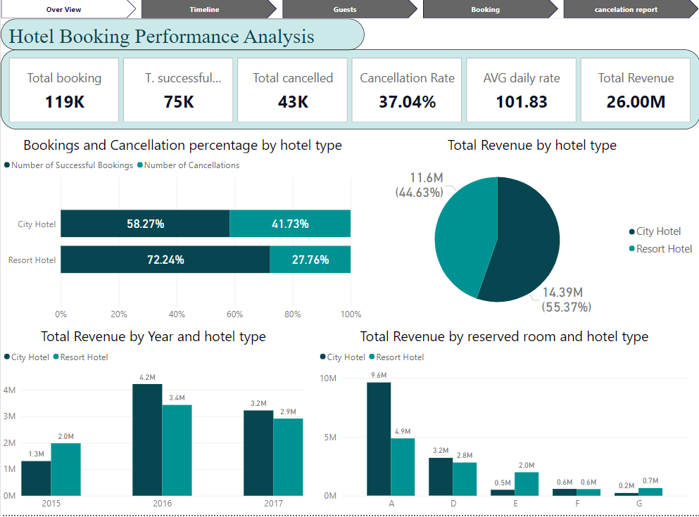

Slide 13
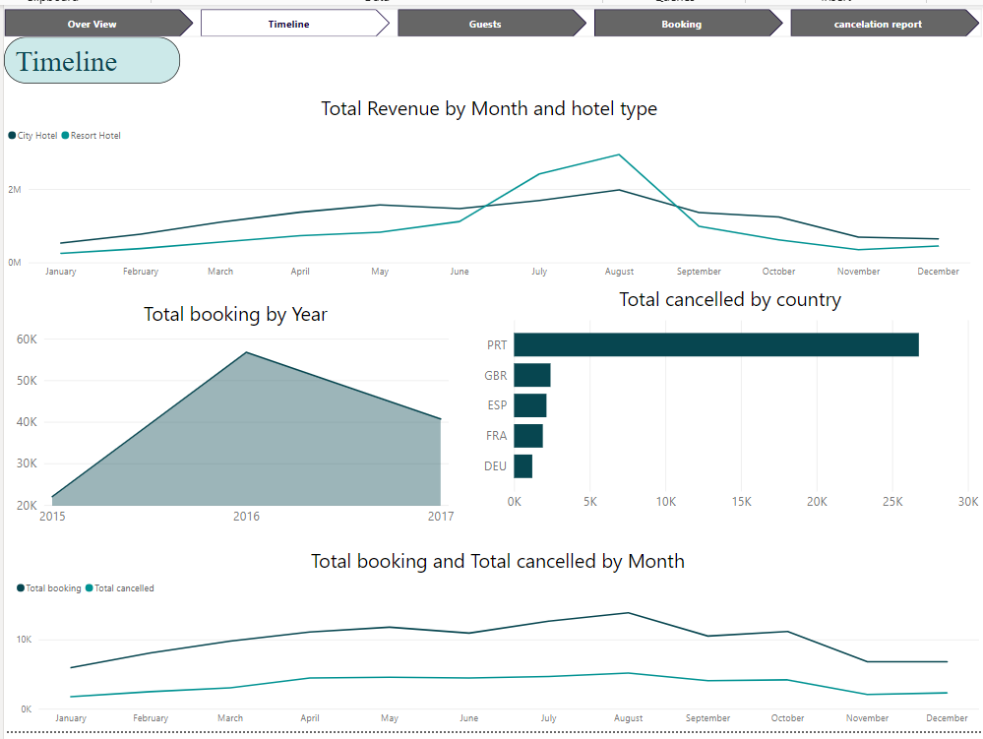

Slide 14
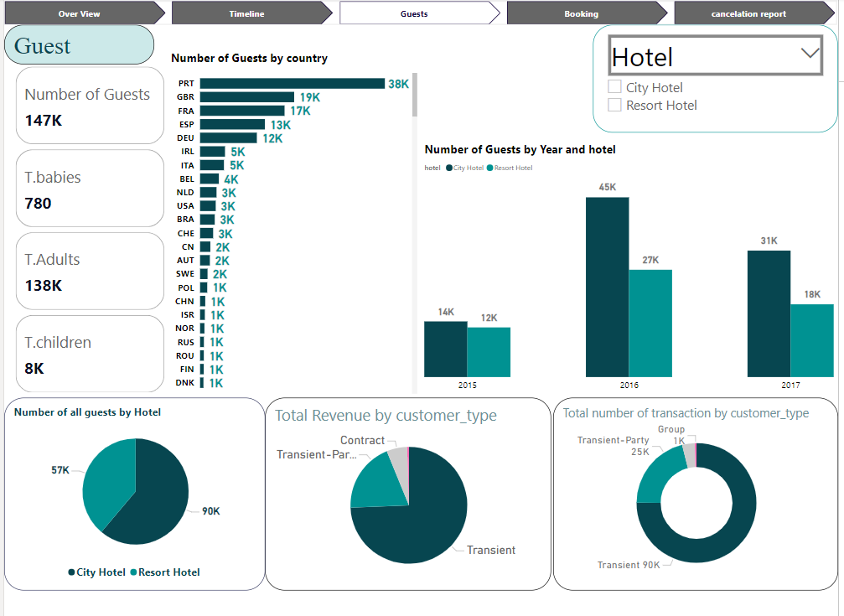

Slide 15
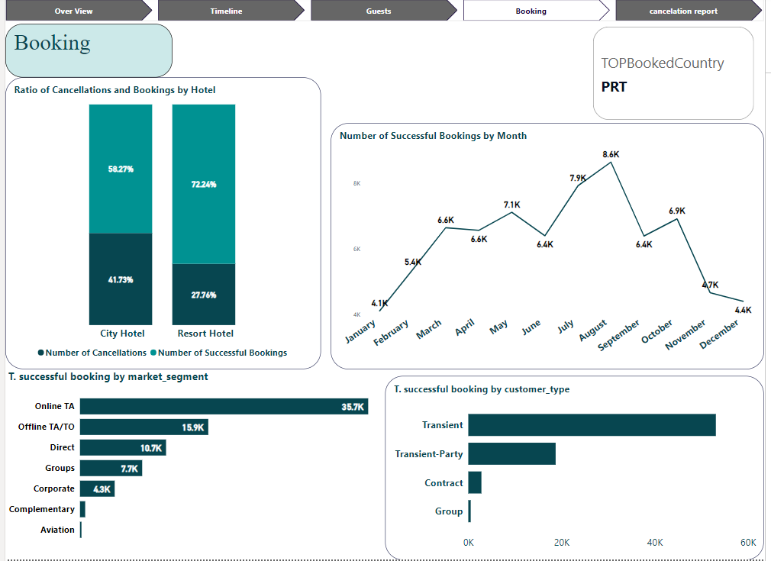

Slide 16
